Slide 1
Optimal Algorithms for Ranked Enumeration of Answers to Full Conjunctive Queries
Nikolaos Tziavelis¹, Deepak Ajwani², Wolfgang Gatterbauer¹, Mirek Riedewald¹, Xiaofeng Yang³
Ranked results
¹Northeastern University, Boston, ²University College Dublin, ³VMWare
Time
Project Page: https://northeastern-datalab.github.io/anyk/
Data Lab: https://db.khoury.northeastern.edu
This work is licensed under a Creative Commons Attribution-Noncommercial-Share Alike 4.0 International License. See https://creativecommons.org/licenses/by-nc-sa/4.0/ for details

Slide 2
Ranked Enumeration Example
join
join
$$R$$
$$S$$
$$T$$
$$A$$
$$B$$
$$w$$
$$B$$
$$C$$
$$w$$
$$C$$
$$D$$
$$w$$
select A, B, C, D, R.w + S.w + T.w as weight
from R, S, T
where R.B=S.B and S.C=T.C
order by weight ASC
limit k any-k
select A, B, C, D from R, S, T
where R.B=S.B and S.C=T.C
1
0
$$1$$
0
1
$$5$$
1
1
$$20$$
2
0
$$2$$
0
2
$$7$$
1
2
$$40$$
3
1
$$3$$
1
1
$$8$$
2
3
$$10$$
4
3
$$4$$
1
2
$$9$$
2
4
$$30$$
Enumerate results in order
Weights
Rank-1
Rank-2
Rank-3
(1, 0, 2, 3, 18)
(2, 0, 2, 3, 19)
(3, 1, 2, 3, 22)
…
SUM of weights

Slide 3
Ranked Enumeration: Problem Definition
“Any-k” Anytime algorithms + Top-k for Conjunctive Queries
TTL
#results
Most important results first
(ranking function on output tuples, e.g. sum of weights)
All results eventually returned
No need to set k in advance
k+1
k
TTF
time
Delay(k)
RAM Cost Model:
$TTF$ = Time-to-First = $TT\left(1\right)$
Delay(k) = Time between Rank-k and Rank-(k+1)
$TTL$ = Time-to-Last = $TT\left(|out|\right)$

Slide 4
Conceptual Roadmap
Paths/Serial
Cyclic/General
Join Problems
Top-1 Path Queries
Top-1 Conjunctive Queries
Optimization
DP
Union of Tree-DP (UT-DP)
Ranked Enumeration
Any-k DP
Any-k UT-DP
Tropical semiring (min, +)
Any-k UT-DP over selective dioids

Slide 5
Main Result
$n$: database size
Query = fixed size
For Acyclic Queries:
$TTF$ = $O(n)$
Delay($k$) = $O(logk)$
We get $k$ results (sorted) in just $O(n +k logk)$ for any $k$!
For Cyclic Queries:
Higher $TTF$, according to best tree decomposition(s) available
Inherent cost of cyclicity

Slide 6
Top-1: Dynamic Programming
Bottom-up
Top-1 Path Queries
Top-1 CQs
DP
UT-DP
$$R$$
$$S$$
$$T$$
Any-k DP
Any-k UT-DP
17
25
20
Any-k UT-DP over selective dioids
1
5
20
18
17
40
18
2
7
40
0
Nodes: tuples
Edges: joining pairs
Labels: tuple weights
0
22
28
10
0
source
3
8
10
terminal
∞
19
30
Bottom-up values: min total weight
4
9
30
Paths: join results
Top-down for Top-1 result

Slide 7
Any-k DP: k-shortest paths
2nd Best Result = 2nd Shortest Path (19)
Top-1 Path Queries
Top-1 CQs
DP
UT-DP
$$R$$
$$S$$
$$T$$
Any-k DP
Any-k UT-DP
17
25
20
Any-k UT-DP over selective dioids
1
5
20
18
17
40
18
2
7
40
0
0
22
28
10
0
source
3
8
10
terminal
∞
19
30
4
9
30
Best result = Shortest Path (18)

Slide 8
Any-k DP Algorithms: 2 non-dominated families
Anyk-Part
Anyk-Rec
Repeatedly partitions the solution space.
Relies on [Lawler MS’76]
Wins when k is small.
Recursively computes lower-rank paths (suffixes) and reuses them. Inspired by[Jiménez+ WEA’03]
Wins when k is large.
$n$: database size
$l$: query size
$$TTF=O\left(ln\right)$$
$$Delay\left(k\right)=O(logn∙l)$$
Variants
Eager
All [Yang+ WWW’18]
Lazy [Chang+ VLDB’15]
Take2
$$TTF=O\left(ln\right)$$
$$Delay\left(k\right)=O(logk+l)$$
Reusing computation may pay off – can be even faster than sorting!
For Cartesian product with $n^{ℓ}$ results:
Anyk-Rec TTL: $O\left(n^{ℓ}(\log{n}+ℓ)\right)$
Batch-Sorting/Anyk-Part: $O\left(n^{ℓ}\log{n}∙ ℓ\right)$
Lowest delay given linear-time pre-processing!

Slide 9
Generalizations
Paths → Trees (Acyclic)
Trees → Cycles
Decompose into a union of acyclic queries
e.g. 6-cycle $TTF=O\left(n^{5/3}\right)$ same as state-of-the-art Boolean query
Ranking Function besides minimum sum of weights? ($min$, $+$)
($min$, $max$): min traffic congestion
($max$, $×$) for non-negative reals: highest-prob. results
Lexicographic ordering (any, independent of join order)
Algebraic characterization as selective dioids
Top-1 Path Queries
Top-1 CQs
DP
UT-DP
Any-k DP
Any-k UT-DP
Any-k UT-DP over selective dioids

Slide 10
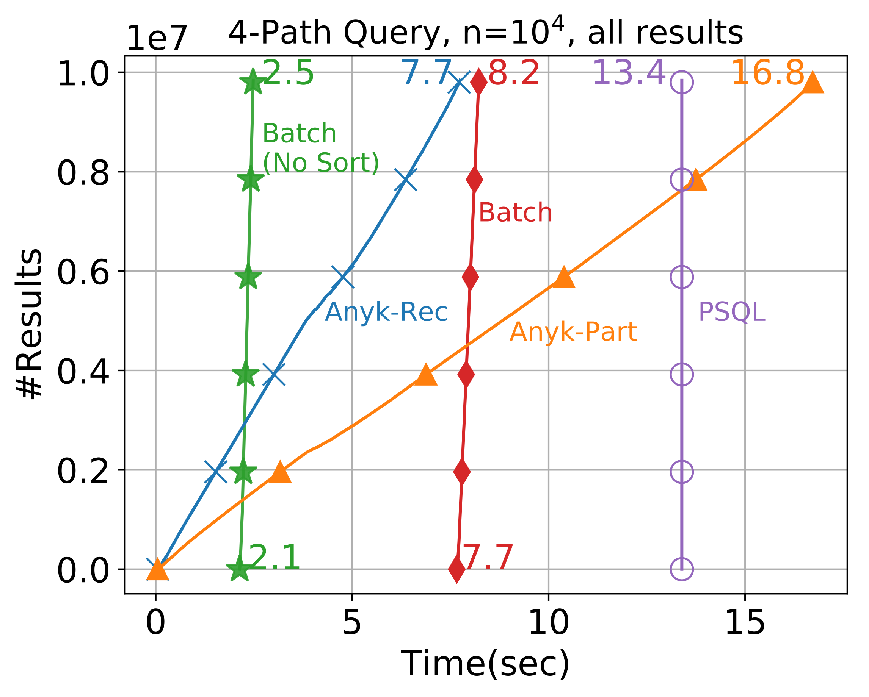
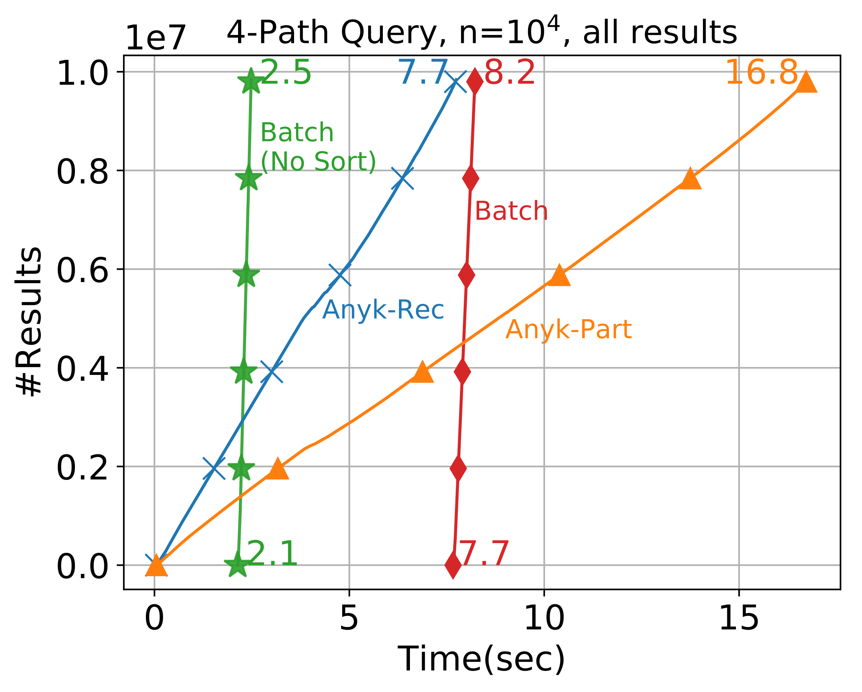
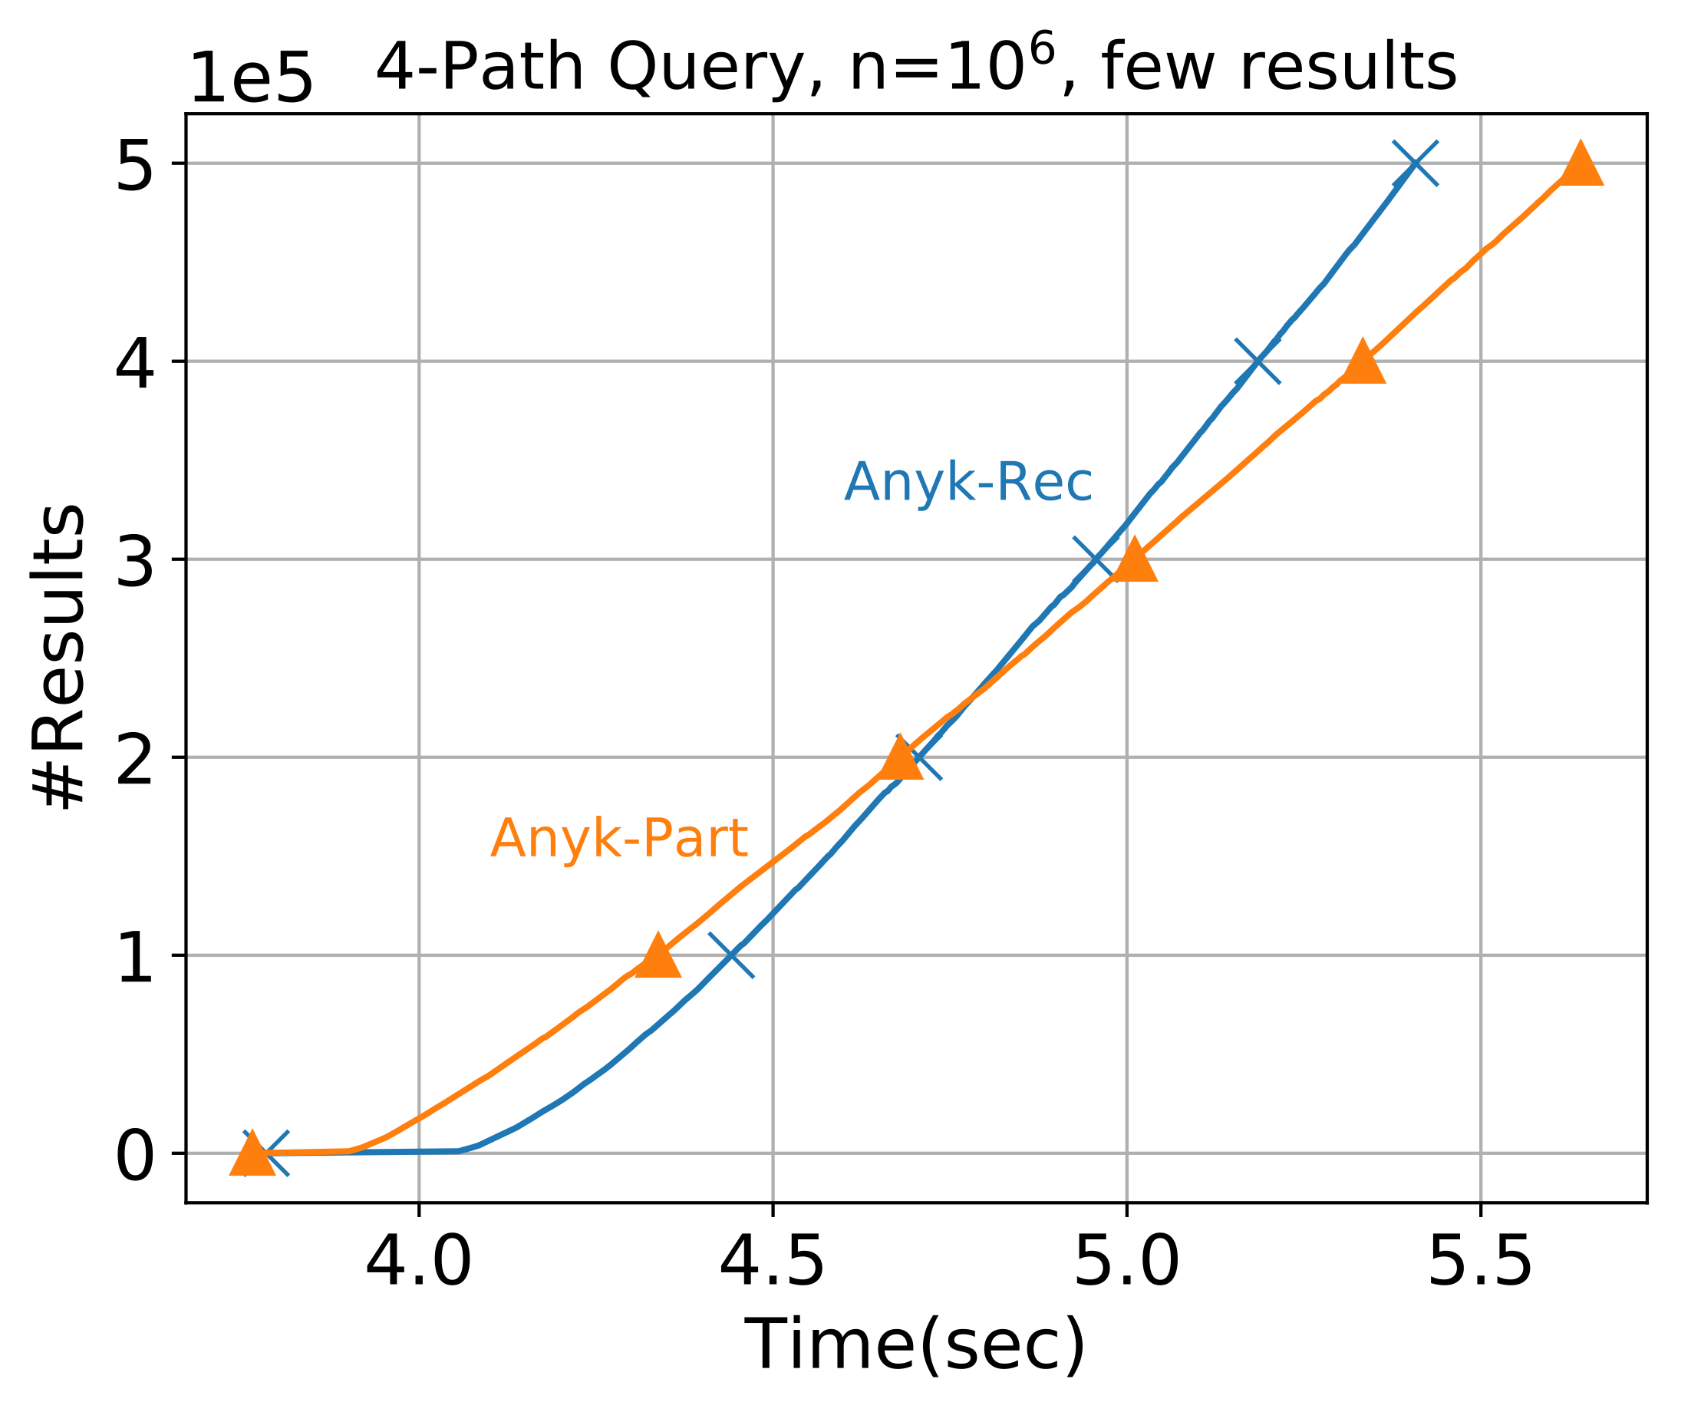
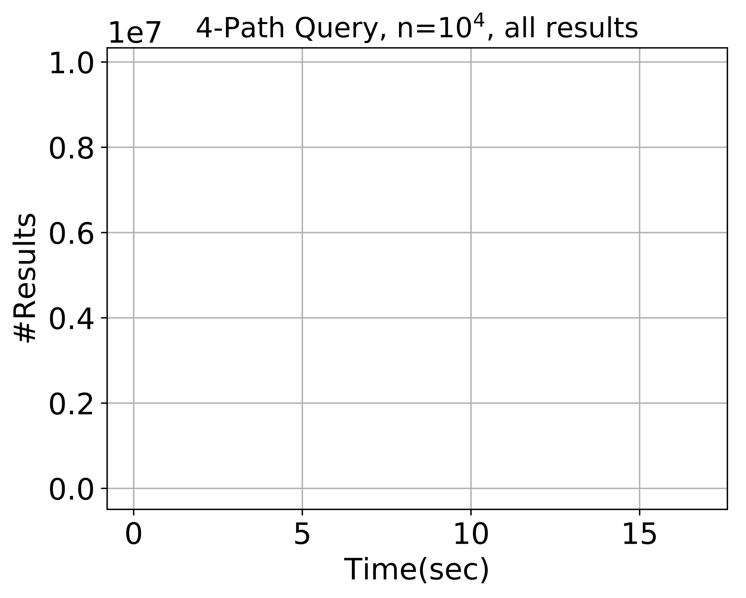
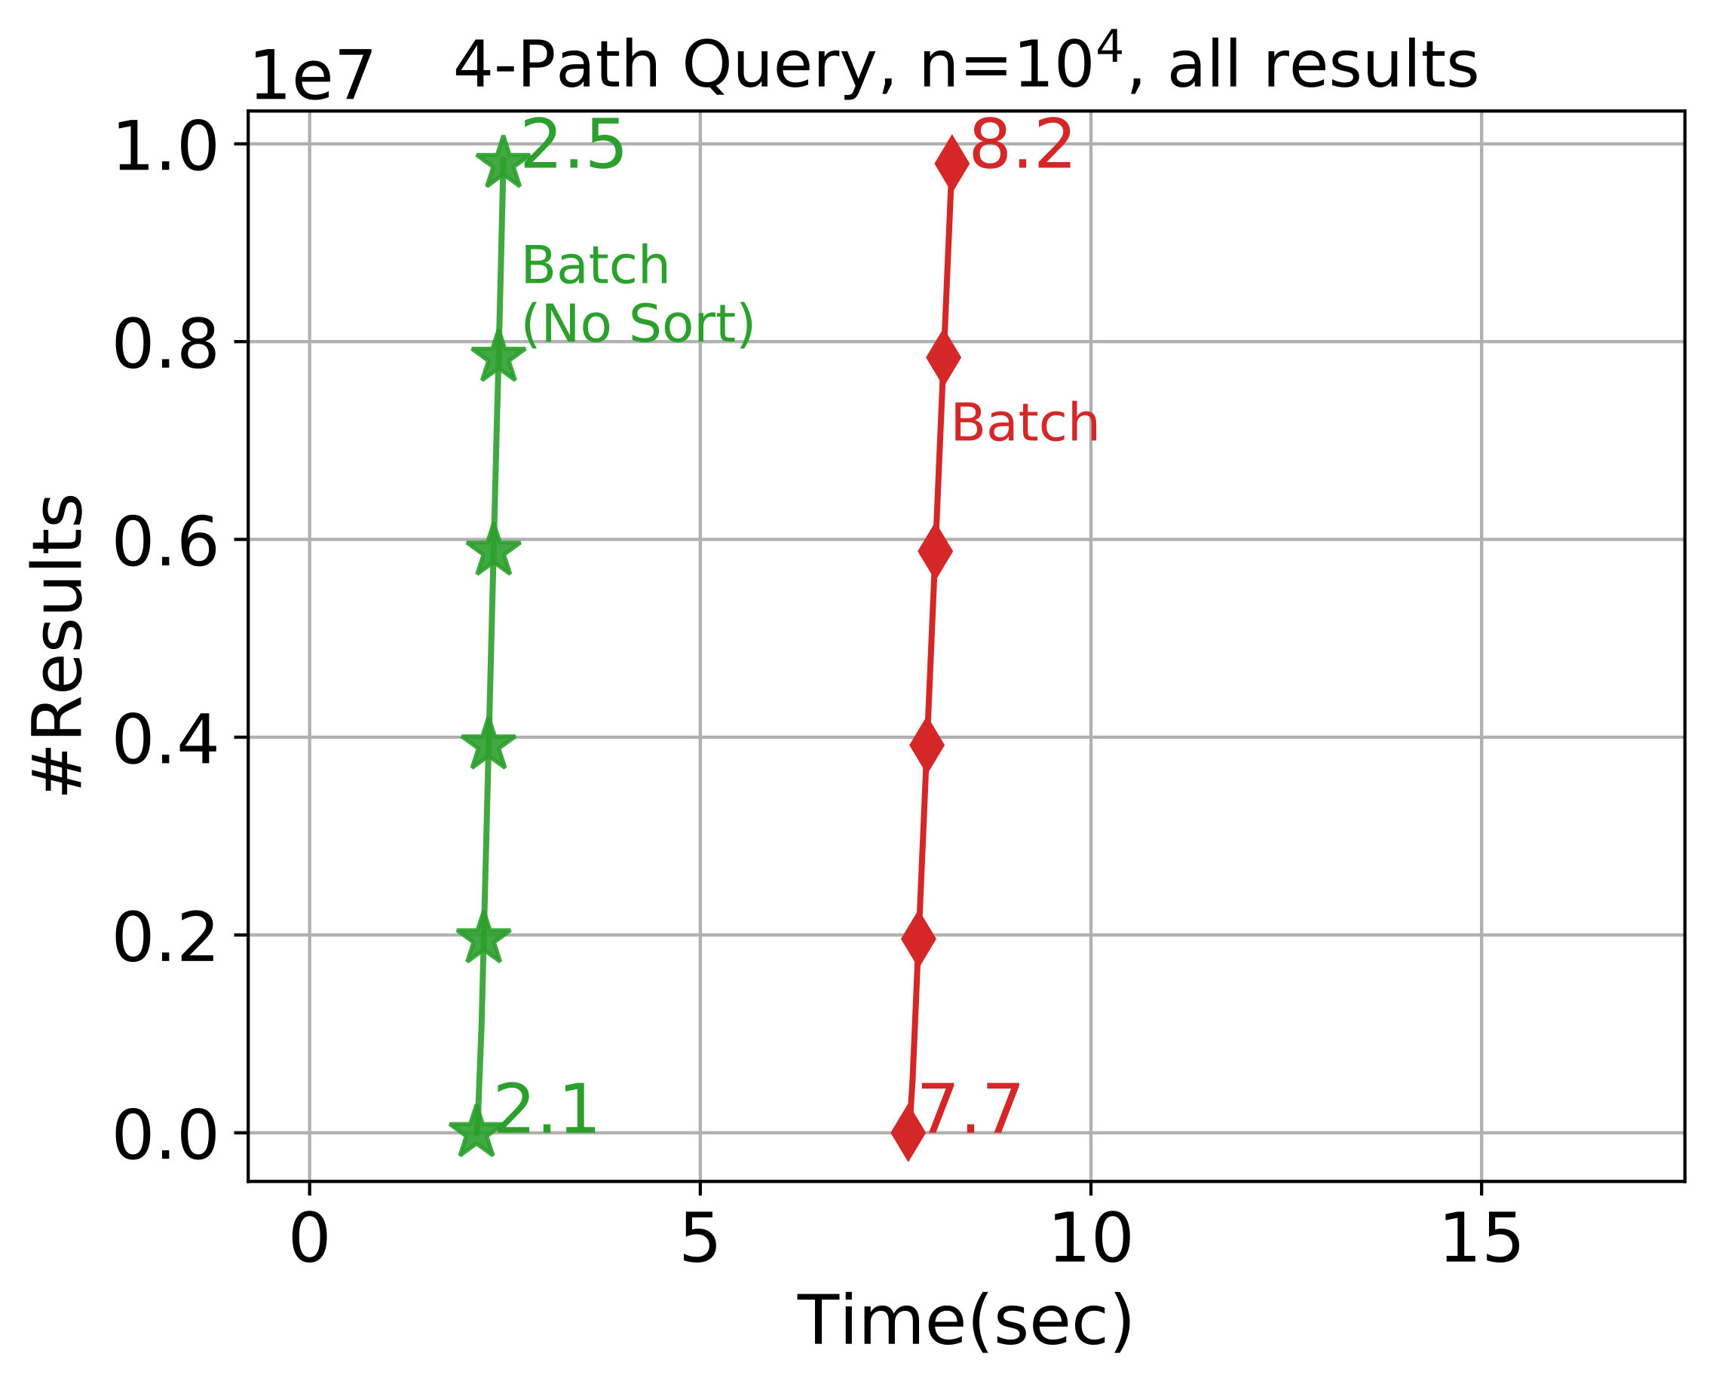
Experiments
?
Anyk starts much faster than Batch
Anyk-Rec also finishes faster than Batch
Anyk-Part is usually faster in the beginning

Slide 11
Conclusions
Ranked enumeration of arbitrary conjunctive queries [Yang+ ExploreDB’18]
Linear pre-processing (or higher for cyclic)
Logarithmic delay
Two competing algorithmic approaches
Acknowledgements
National Institutes of Health (NIH) award number R01NS091421
National Science Foundation (NSF) award number CAREER IIS-1762268

