Slide 1
Beyond Equi-joins: Ranking, Enumeration and Factorization
Nikolaos Tziavelis, Wolfgang Gatterbauer, Mirek Riedewald
Ranked results
Northeastern University, Boston
Time
Website: https://northeastern-datalab.github.io/anyk/
Data Lab: https://db.khoury.northeastern.edu
This work is licensed under a Creative Commons Attribution-Noncommercial-Share Alike 4.0 International License. See https://creativecommons.org/licenses/by-nc-sa/4.0/ for details

Slide 2
Motivating Example
Reddit Network
c2
Timestamp
Sentiment measure
Readability score
c1
c3
c4
c5
[K+ 18] Kumar, Hamilton, Leskovec, Jurafsky. Community Interaction and Conflict on the Web. WWW’18. https://doi.org/10.1145/3178876.3186141

Slide 3
Motivating Example
Reddit Network
Join in SQL:
select *
from Reddit R1, Reddit R2
where R2.Source = R1.Target
AND R2.Timestamp > R1.Timestamp
AND R2.Sentiment < R1.Sentiment
order by weight desc
limit 1000
, R1.Readability + R2.Readability as weight
c2
(Timestamp1, Sentiment1)
Equality
c1
c3
<
>
Inequalities
(Timestamp2, Sentiment2)
c4
c5
Ranking
Q: - length-2 paths
- timestamps in increasing order
- sentiment in decreasing order
- top results by sum of readability
Naïve plan:
Compute all $O(n^{2})$ join results
Sort them
Our approach: $O(n+k)$ for $k$ results (ignoring log factors)

Slide 4
Ranked Enumeration for Join Queries
Generalizes top-k
DB
Ranked Enumeration (“Any-k”)
$n$ tuples
#results
k
Ranking function:
sum-of-weights
Join
R
$ℓ$ relations
S
T
Preprocessing
Time-to-k TT(k)
time
U
W
Assumptions
Data complexity ($ℓ$, #attributes constant)
Indexes have to be built on-the-fly
In-memory computation
Lower bound: $TT\left(k\right)=O(n+k)$
Equi-joins [T+20]: $TT\left(k\right)=O(n+k\log{k})$
(full acyclic)
This work: $TT\left(k\right)=O(n polylog n+k\log{k})$
for full acyclic queries, and DNFs of equality/inequality predicates
[T+20] Tziavelis, Ajwani, Gatterbauer, Riedewald, Yang. Optimal Algorithms for Ranked Enumeration of Answers to Full Conjunctive Queries. PVLDB’20 https://doi.org/10.14778/3397230.3397250

Slide 5
Overview of our Approach
1. Preprocessing Phase
2. Enumeration Phase
Factorized Representation
Any-k Algorithms
Compact representation of all query results
Traverse the representation, prioritizing solutions according to ranking
$$×$$
Size of full output: $O(n^{ℓ})$
Size of representation: $O(n polylog n)$
Same framework as equi-join case
n = #tuples
$ℓ$ = #relations

Slide 7
Factorized Representation for (Acyclic) Equi-joins
Enumeration Graph
S(A,B)
1,1
1,2
2,3
3,5
3,6
relation layers (tuples)
1,1
3,4
S.B = T.B
1
connection layers (attribute values)
1
2
3
T(B,C)
1,1
1,2
2,3
3,5
3,6
1,1
3,4
path = join result
T.C = R.C
1
1
2
3
R(C,D)
$O(n)$ time and space (via hashing)
but encodes all join results
1,1
1,2
1,3
2,5
3,6
1,1
1,4
[T+20] Tziavelis, Ajwani, Gatterbauer, Riedewald, Yang. Optimal Algorithms for Ranked Enumeration of Answers to Full Conjunctive Queries. PVLDB’20 https://doi.org/10.14778/3397230.3397250

Slide 8
Enumeration Phase for (Acyclic) Equi-joins
Enumeration Graph
Top-down
S(A,B)
1,1
1,2
2,3
3,4
3,5
3,6
k-shortest paths (or “k-lightest subtrees”)
Traversal with Priority Queues
1
2
3
T(A,C)
1,1
1,2
2,3
3,4
3,5
3,6
1
2
3
Bottom-up
R(A,D)
Dynamic Programming
Propagate minimum weight up
1,1
1,2
1,3
1,4
2,5
3,6
[T+20] Tziavelis, Ajwani, Gatterbauer, Riedewald, Yang. Optimal Algorithms for Ranked Enumeration of Answers to Full Conjunctive Queries. PVLDB’20 https://doi.org/10.14778/3397230.3397250

Slide 10
Factorized Representation for (Acyclic) Theta-Joins
Enumeration Graph
S(A,B)
1,1
1,2
2,3
3,4
3,5
3,6
relation layers (tuples)
Tuple-Level Factorization Graph (TLFG)
DAG between 2 relation layers
Path from S tuple to T tuple ⇔ Valid join pair
Ranked enumeration for any TLFG
Size affects preprocessing time
Depth (longest path) affects delay
S.B < T.D
T(C,D)
1,1
1,2
2,3
3,4
3,5
3,6
T.C > R.E
R(E,F)
1,2
1,3
2,5
3,6
1,1
1,4

Slide 11
Direct TLFGs
Enumeration Graph
S(A,B)
1,1
1,2
2,3
3,4
3,5
3,6
S.B < T.D
Direct TLFG
$O(n^{2})$ edges
Depth = 1
Works for any join condition
T(C,D)
1,1
1,2
2,3
3,4
3,5
3,6
T.C > R.E
$$TT\left(k\right)=O(n^{2}+k\log{k})$$
R(E,F)
1,2
1,3
2,5
3,6
1,1
1,4

Slide 12
Binary Partitioning for Inequality Predicate
Enumeration Graph
S(A,B)
1,1
1,2
2,3
3,4
3,5
3,6
S.B < T.D
v₁
v₂
v₃
v₄
v₅
Binary Partitioning Method
$O(n\log{n})$ size
Depth = 2
For 1 inequality predicate
T(C,D)
1,1
1,2
2,3
3,4
3,5
3,6
T.C > R.E
$$TT\left(k\right)=O(n\log{n}+k\log{k})$$
R(E,F)
1,2
1,3
2,5
3,6
1,1
1,4
$$⋈_{<}$$
$$⋈_{=}$$
$O(n)$-size relations
$O(n\log{n})$-size relations

Slide 13
Generalization and Extensions
Band predicates (|S.A – T.B| < ε)
Non-equality predicates (S.A ≠ T.B)
Conjunctions/Disjunctions of predicates
Cyclic joins
Higher complexity
Memory consumption analysis
Optimizations for improved memory consumption

Slide 15
Experimental Setup
METHOD | DETAILS
Factorized | Our method
QuadEqui | Direct TLFG (materializes auxiliary relations of size $O(n^{2})$ to reduce theta-join to equi-join) Uses ranked enumeration for equi-joins Time measured after materialization
Batch | Time to rank all results with a Priority Queue Time for join not measured
PSQL | Prebuilt indexes Limit clause
System X | Commercial DBMS In-memory optimized
Thus, lower bound on any implementation!
Thus, lower bound on any implementation
DBMSs

Slide 16
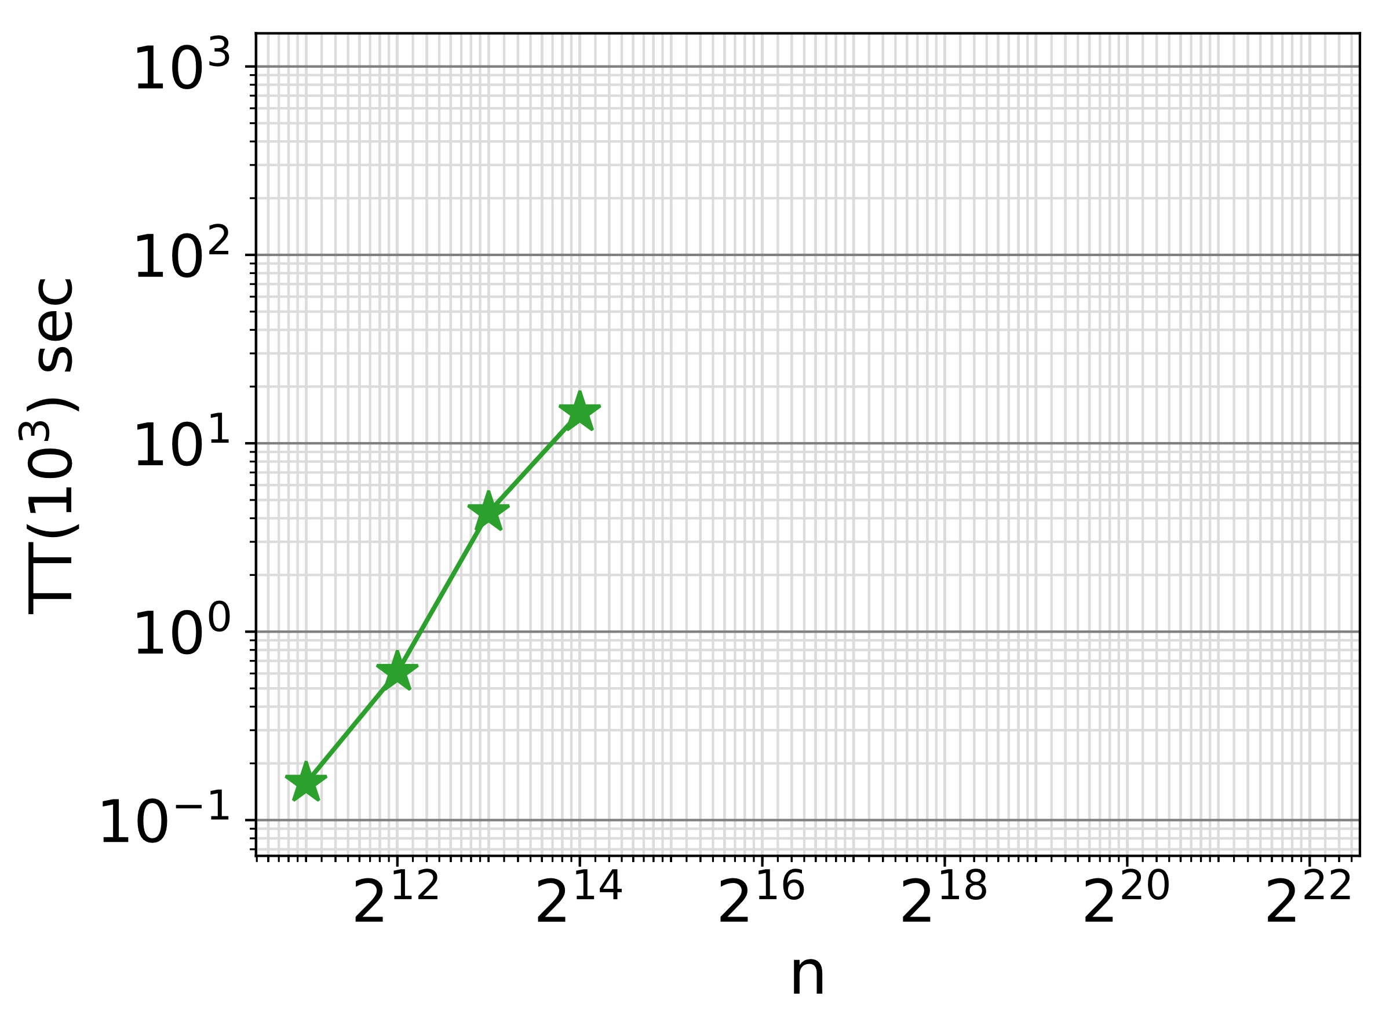
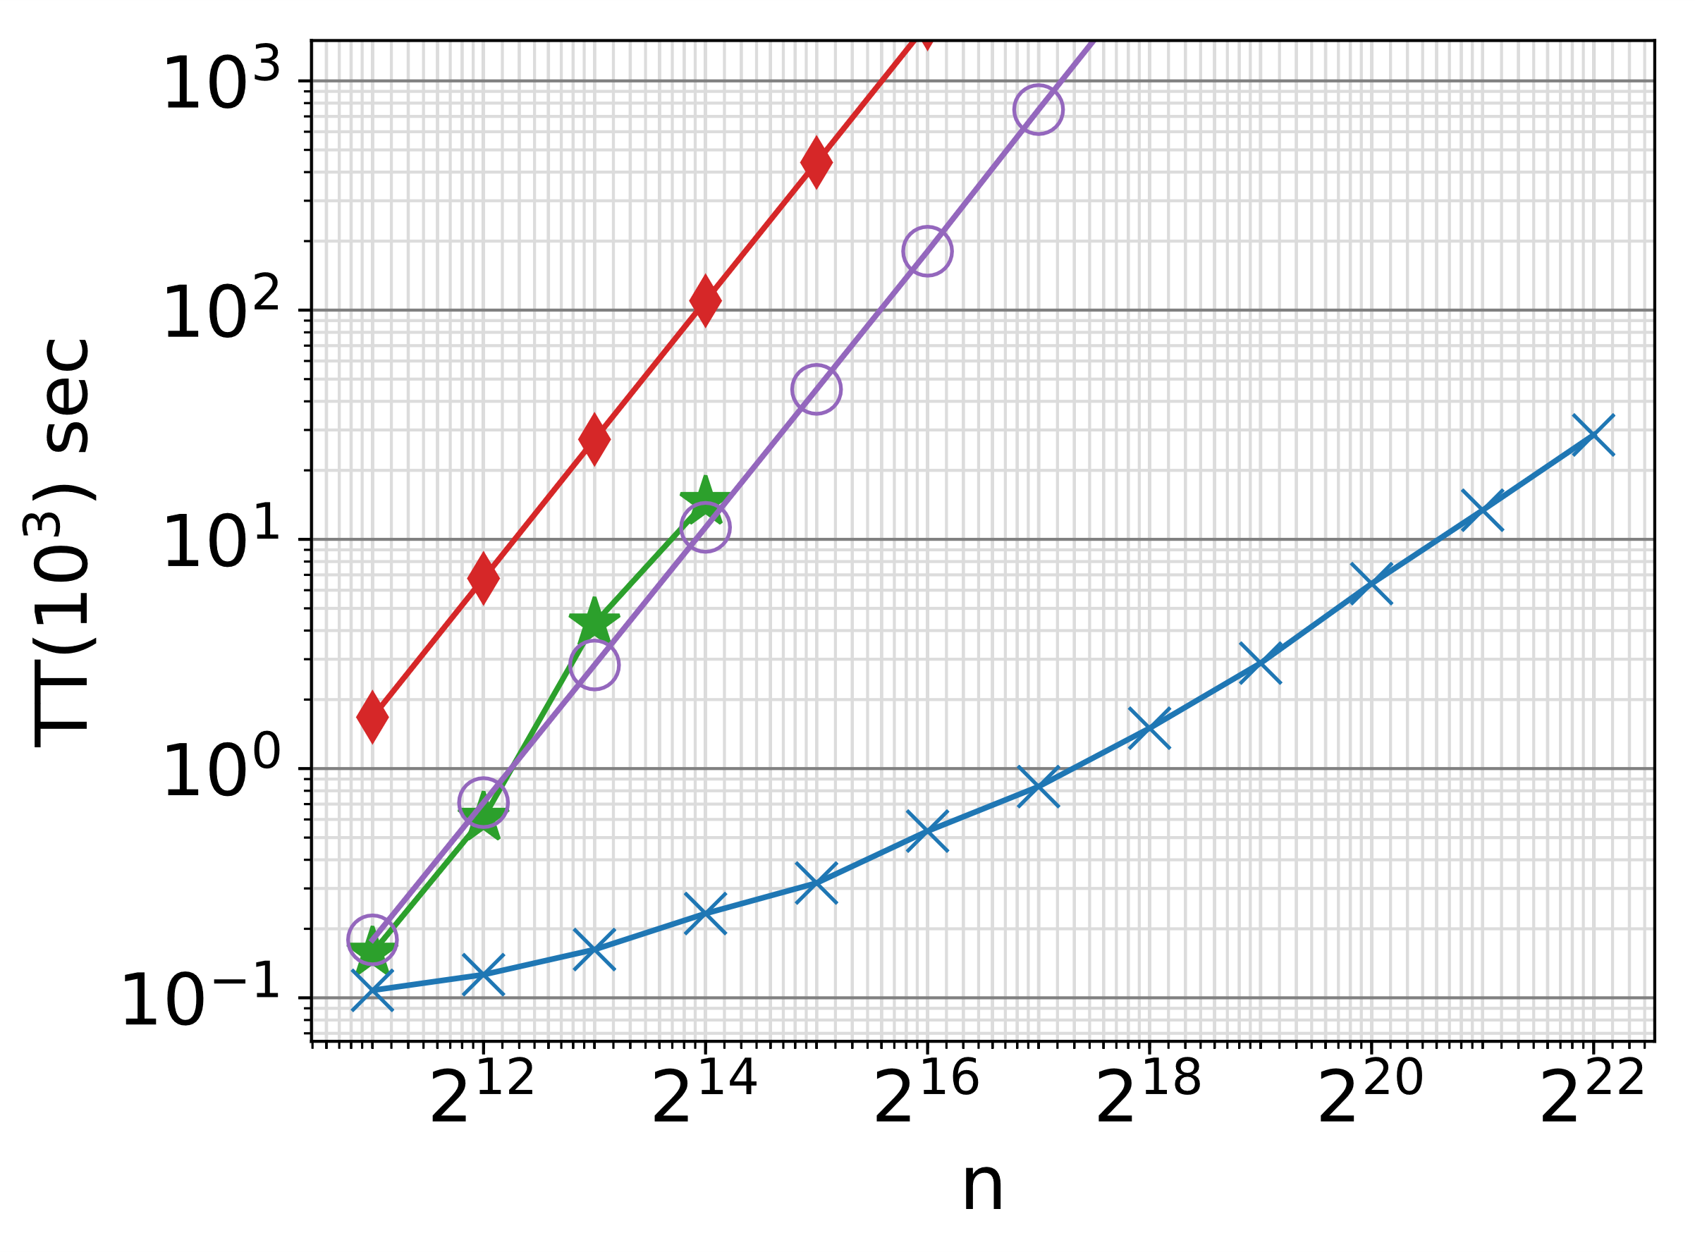
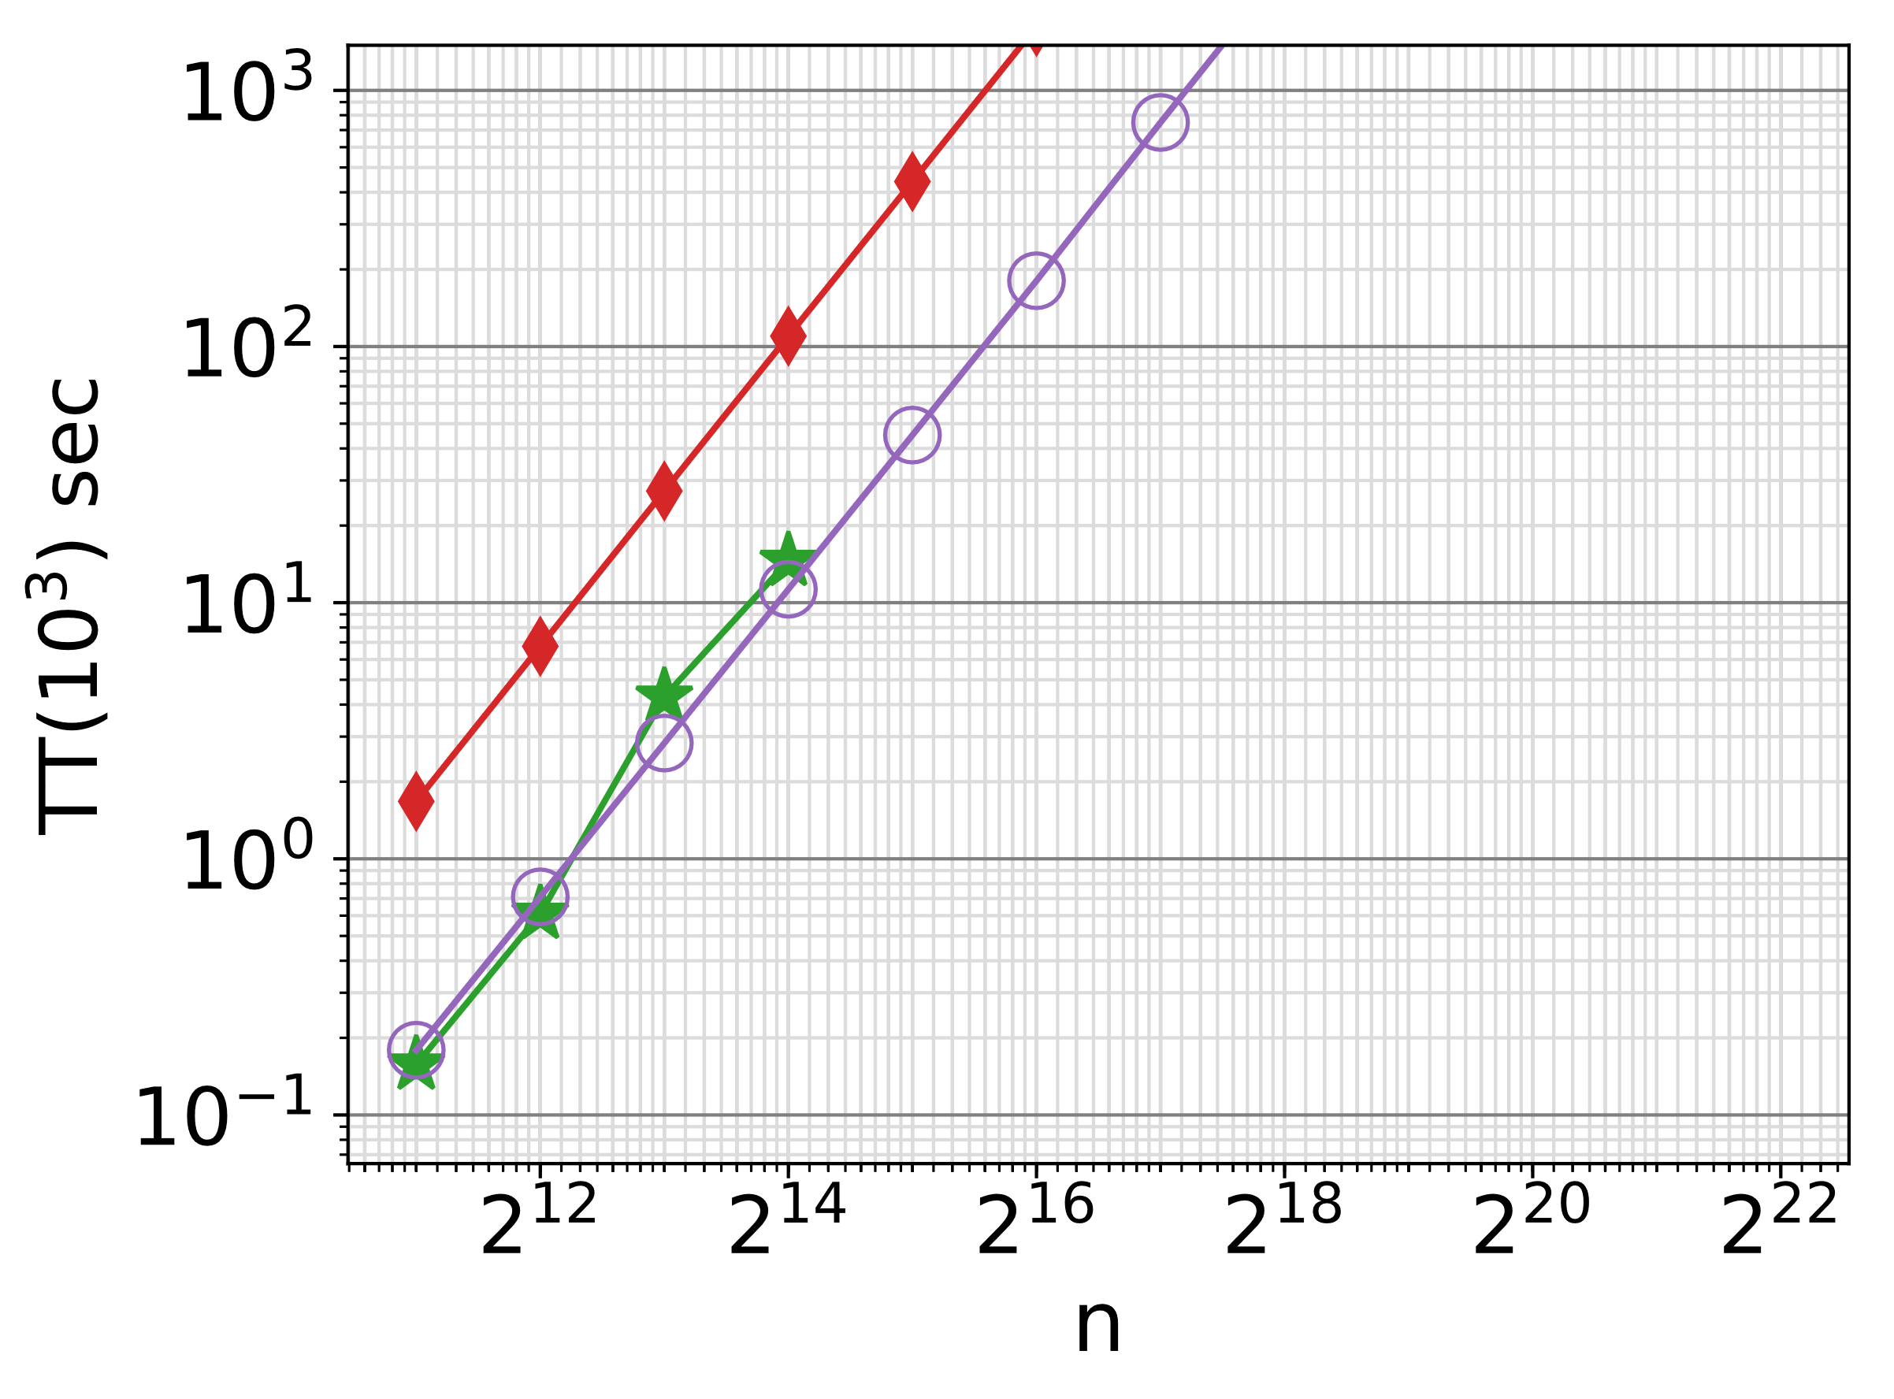
Exp1: Synthetic Data
S_{i}(A_{i}, A_{i+1}, W)
Tuples values drawn randomly from integer domain
Binary join with one inequality predicate
Top-1000
PSQL
System X
Out-of-Memory
Batch=QuadEqui
Factorized
256$×$ larger database
select *, S1.W + S2.W as weight from S1, S2 where S1.A2 < S2.A3 order by weight asc
Other methods face memory problems as $n$ increases.
n = relation size

Slide 17
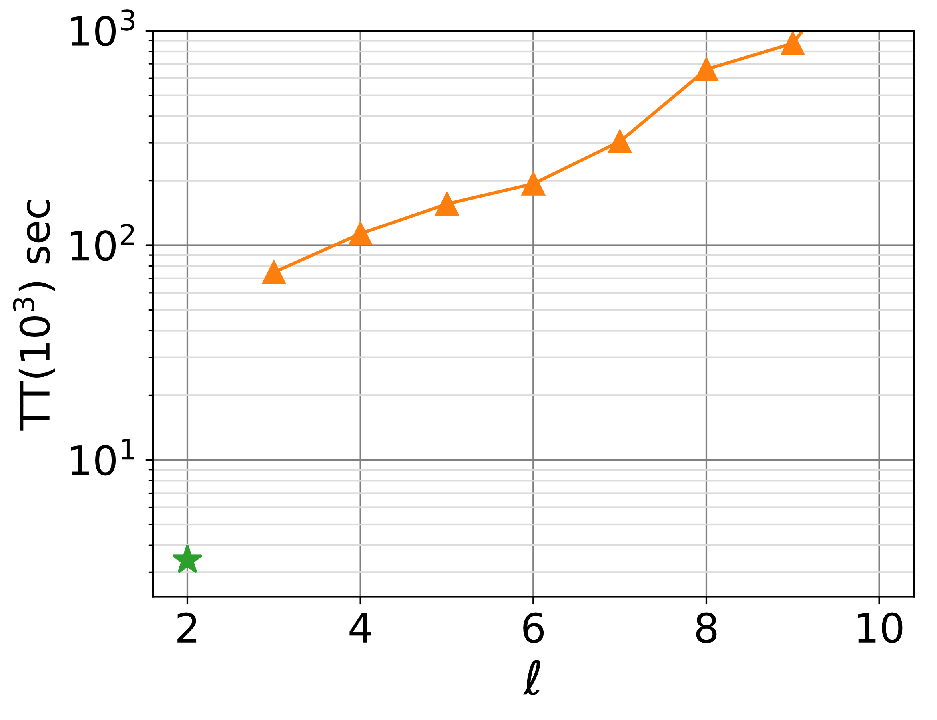
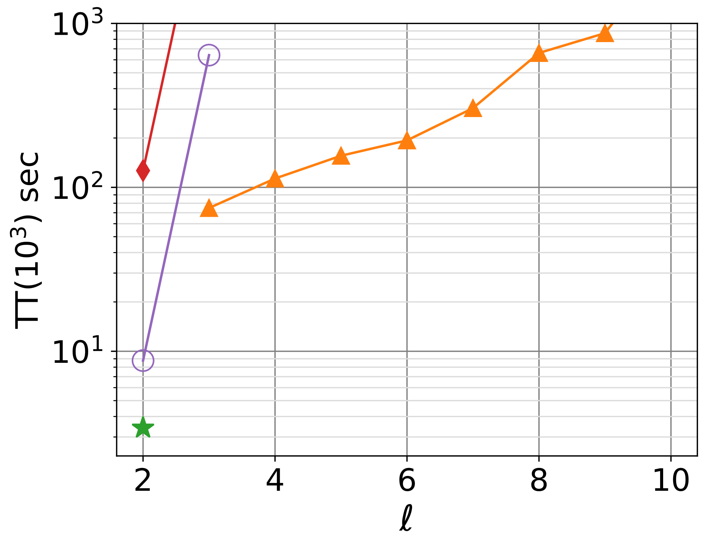
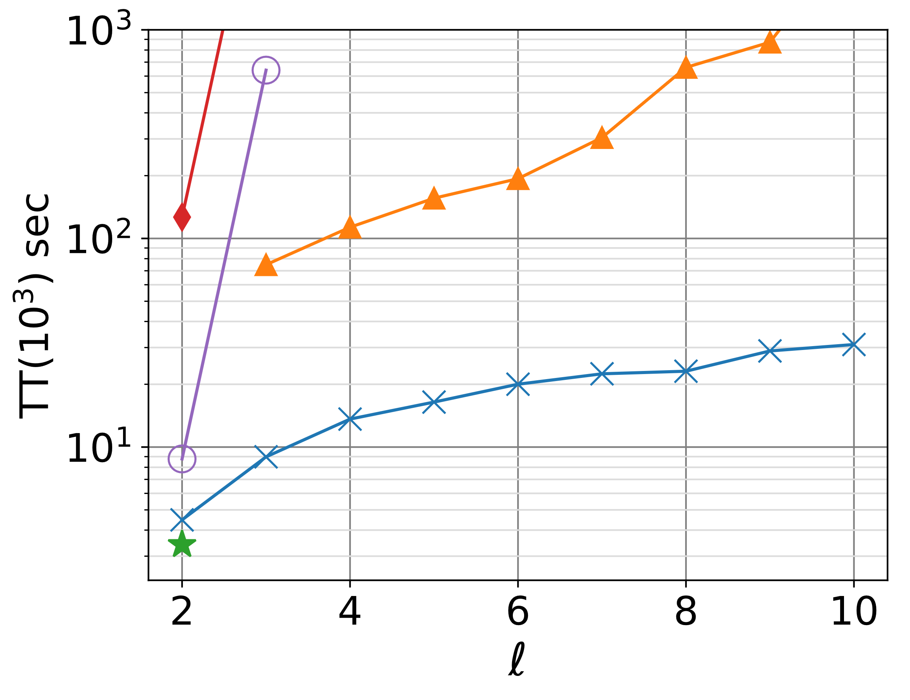
Exp2: Paths on Reddit
$\sim$286k edges
Q: - length-$ℓ$ paths
- timestamps in increasing order
- sentiment in decreasing order
- top results by sum of readability
PSQL
System X
QuadEqui
Factorized
Batch
Out-of-Memory
select *
from Reddit R1, Reddit R2
where R2.Source = R1.Target
AND R2.Timestamp > R1.Timestamp
AND R2.Sentiment < R1.Sentiment
order by weight desc
Our method is robust to different query sizes and complicated join conditions.
$ℓ$ = #relations

Slide 19
Conclusion
DBMSs typically struggle with complex join predicates like inequalities.
The top join results (e.g. top-1000) can be retrieved in time comparable to sorting the input
For (full) acyclic queries with DNFs of equalities and inequalities: $TT\left(k\right)=O\left(n polylog n+k\log{k}\right)$
Even for $O\left(n^{ℓ}\right)$ join results!
Thank you!
Website: https://northeastern-datalab.github.io/anyk/
Code available online!

